Slide 1
Different data types. What to do?

Slide 2
Up to this point, we have been mainly dealing with continuous variables
What do we do when we have more than one data type?
Continuous data
Dichotomous data
Count Data.
Correlated Data
The standard distance metrics do not to a good job dealing with this.

Slide 3
Data Transformation
What we need is to transform our data onto another scale so we can use it to cluster:
Ideally the resultant variable will be:
Continuous
Uncorrelated
On the same scale

Slide 4
The method of choice is that of principal component analysis.
It essentially makes a new set of uncorrelated random variables, by transforming them to a new scale.
Let’s review principle component analysis and the Multivariate Normal distribution.

Slide 5
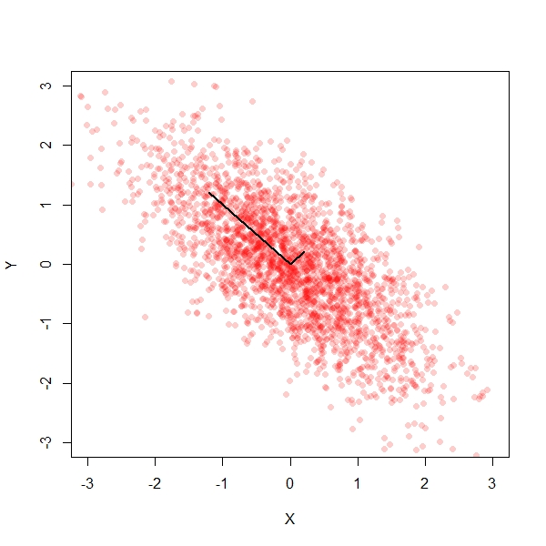
The multivariate normal distribution creates ellipsoid shaped data:

Slide 6
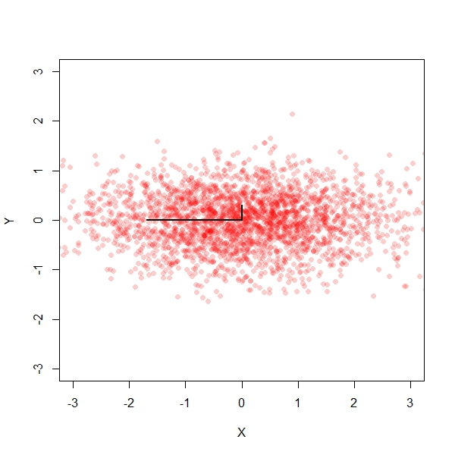
Principal components firsts tilts the data

Slide 7
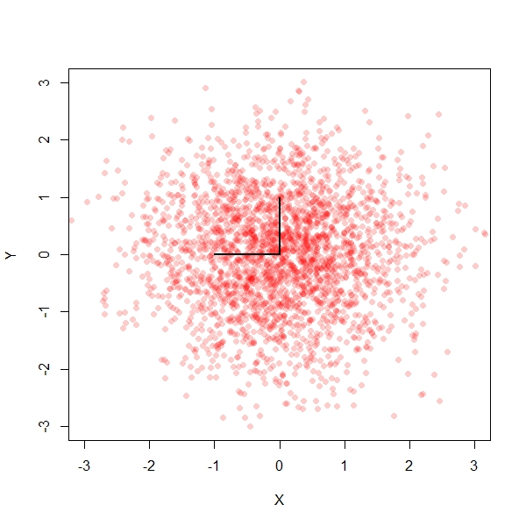
And then standardizes it

Slide 8
So our plan is to:
Take ALL of our data calculate its covariance
Compute the Eigen Vectors/Eigen Values of the covariance.
Mean center our observations
Multiply this centered variable by the Eigen Vector
Then standardize it by the Eigen value (or some other method.
Cluster on these new variables.

Slide 9
Let’s go to the code

Slide 10
Group Names
Now that we have our clusters… We need to name them
We also need to name our “Loadings”

Slide 11
Let’s Go to the spreadsheet.

Slide 12
New Variables-New Problems:
Can’t interpret them directly
Eigen Vectors load on multiple columns … need to interpret this.
Need to work from cluster means for the variables on the original scale to the cluster centroids on this new scale.
Everything we do is based upon this.

Slide 13
First Two Graphs

Slide 14
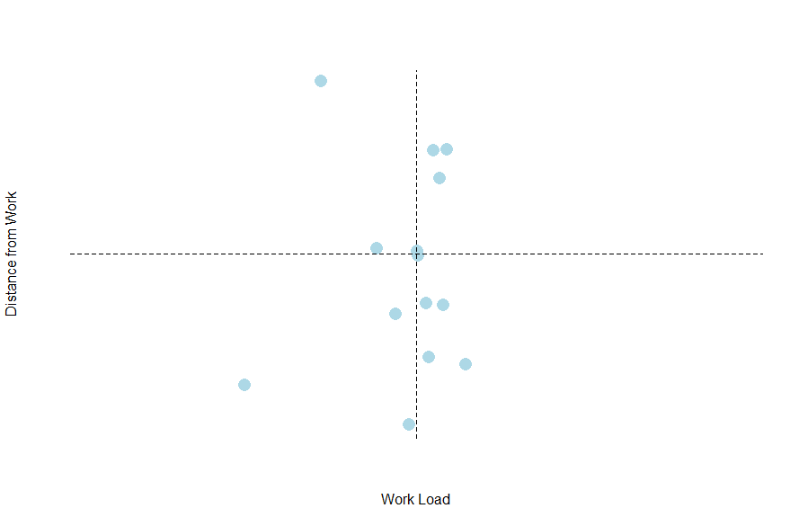

Slide 15
